Slide 1

Credit card fraud detection with machine learning
Duc Le
Interactive Data Analysis

Slide 2
Research Questions
How to tackle an imbalanced dataset & efficiently detect fraud?
What variables are considered important when detecting fraudulent activities?

Slide 3
Synthetic Financial Dataset for Fraud Detection
6,362,620 rows x 11 columns
Classification algorithms: random forest & neural network
Generated by Paysim simulator (source: Kaggle)

Slide 4
Overview
Variables include:
Type: types of payment (Ex: Debit, Transfer or Cash-In/Out).
Amount: amount per transaction.
nameDest: name of the recipient (Customer or Merchant).
oldbalanceOrg: initial balance before the transaction .
newbalanceOrg: new balance after the transaction.
isFraud: whether the transaction is fraudulent or not (dichotomous).

Slide 5

The Problem with Imbalanced Data
Problem: the dataset is extremely imbalanced.
6,354,407 non-frauds vs. 8213 frauds. (Only 0.12% of the transactions are fraudulent).
This limits the credibility of our accuracy.
In other words, if all you have to do is say “yes” (or “no”) 99.99% of the time & still achieve “good” accuracy, then I can train my one year-old nephew to do that, no need to train any model.

Slide 6
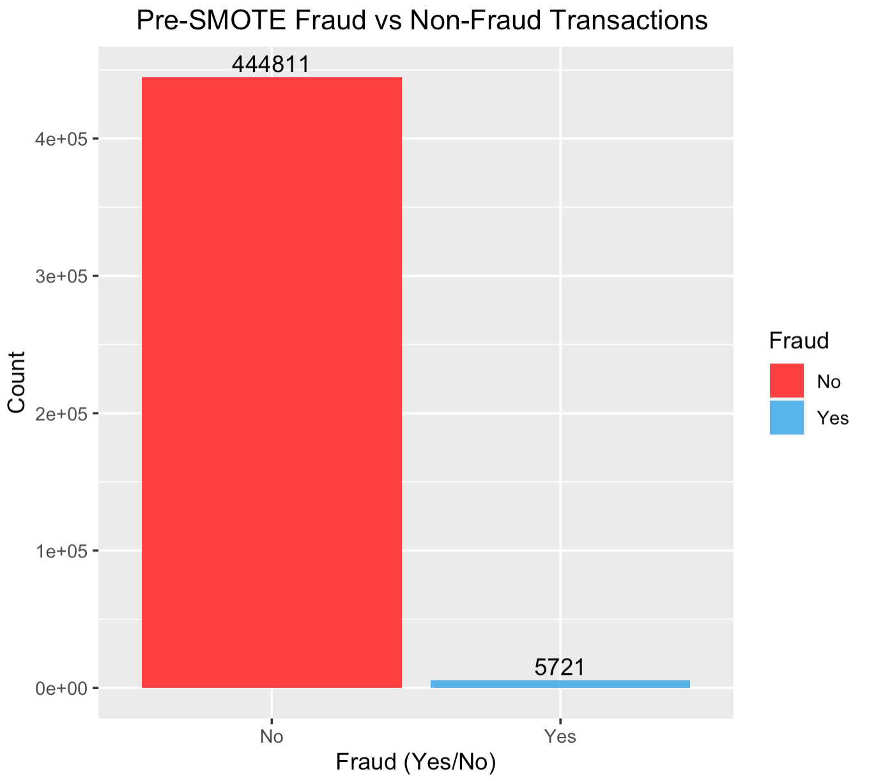
Solution: SMOTE Synthetic Minority Oversampling TEchnique
*Slight modification to conserve some computational expense.
Used a subset of original data for training data.
70-30 train-test split.
Training data is still very imbalanced.
~450k samples.

Slide 7
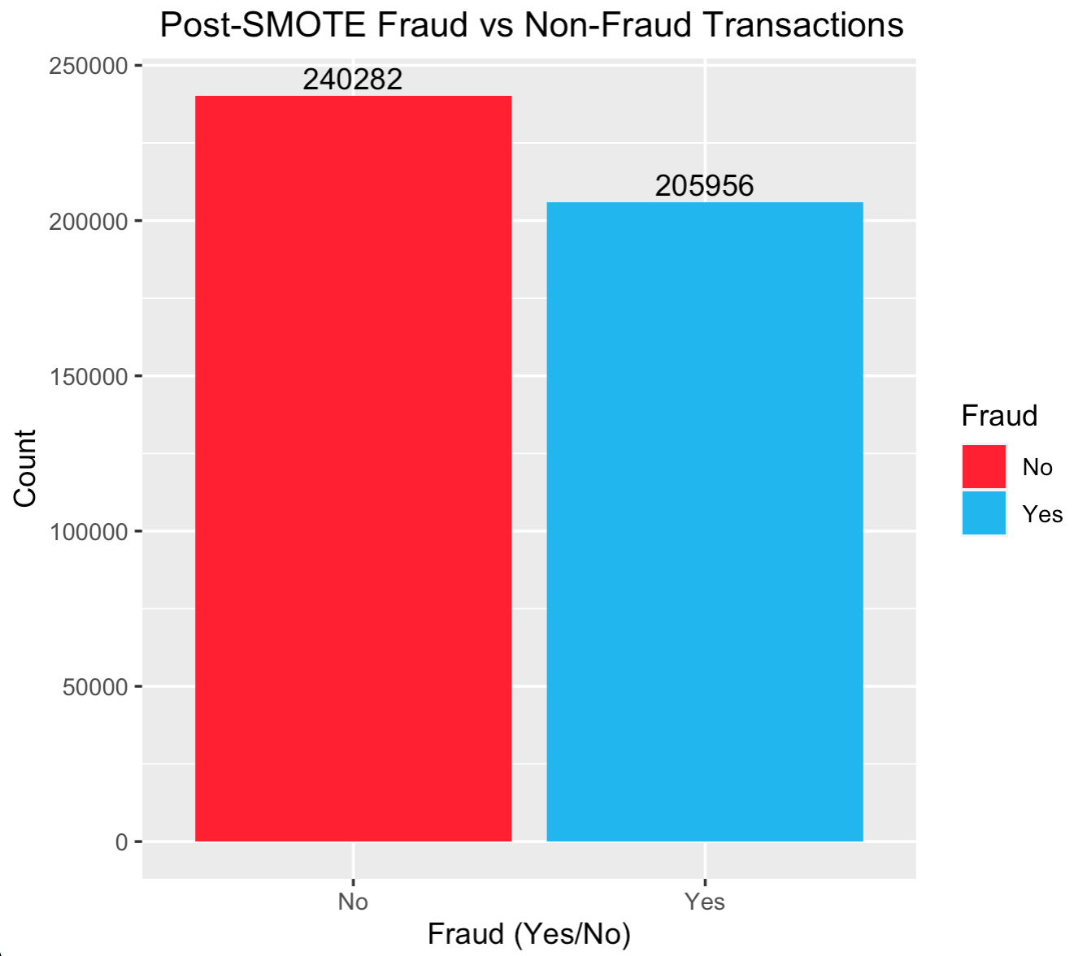
SMOTE Applied
Dataset is much more balanced.
55-45 ratio between frauds vs. non-frauds.
~440k samples.

Slide 8
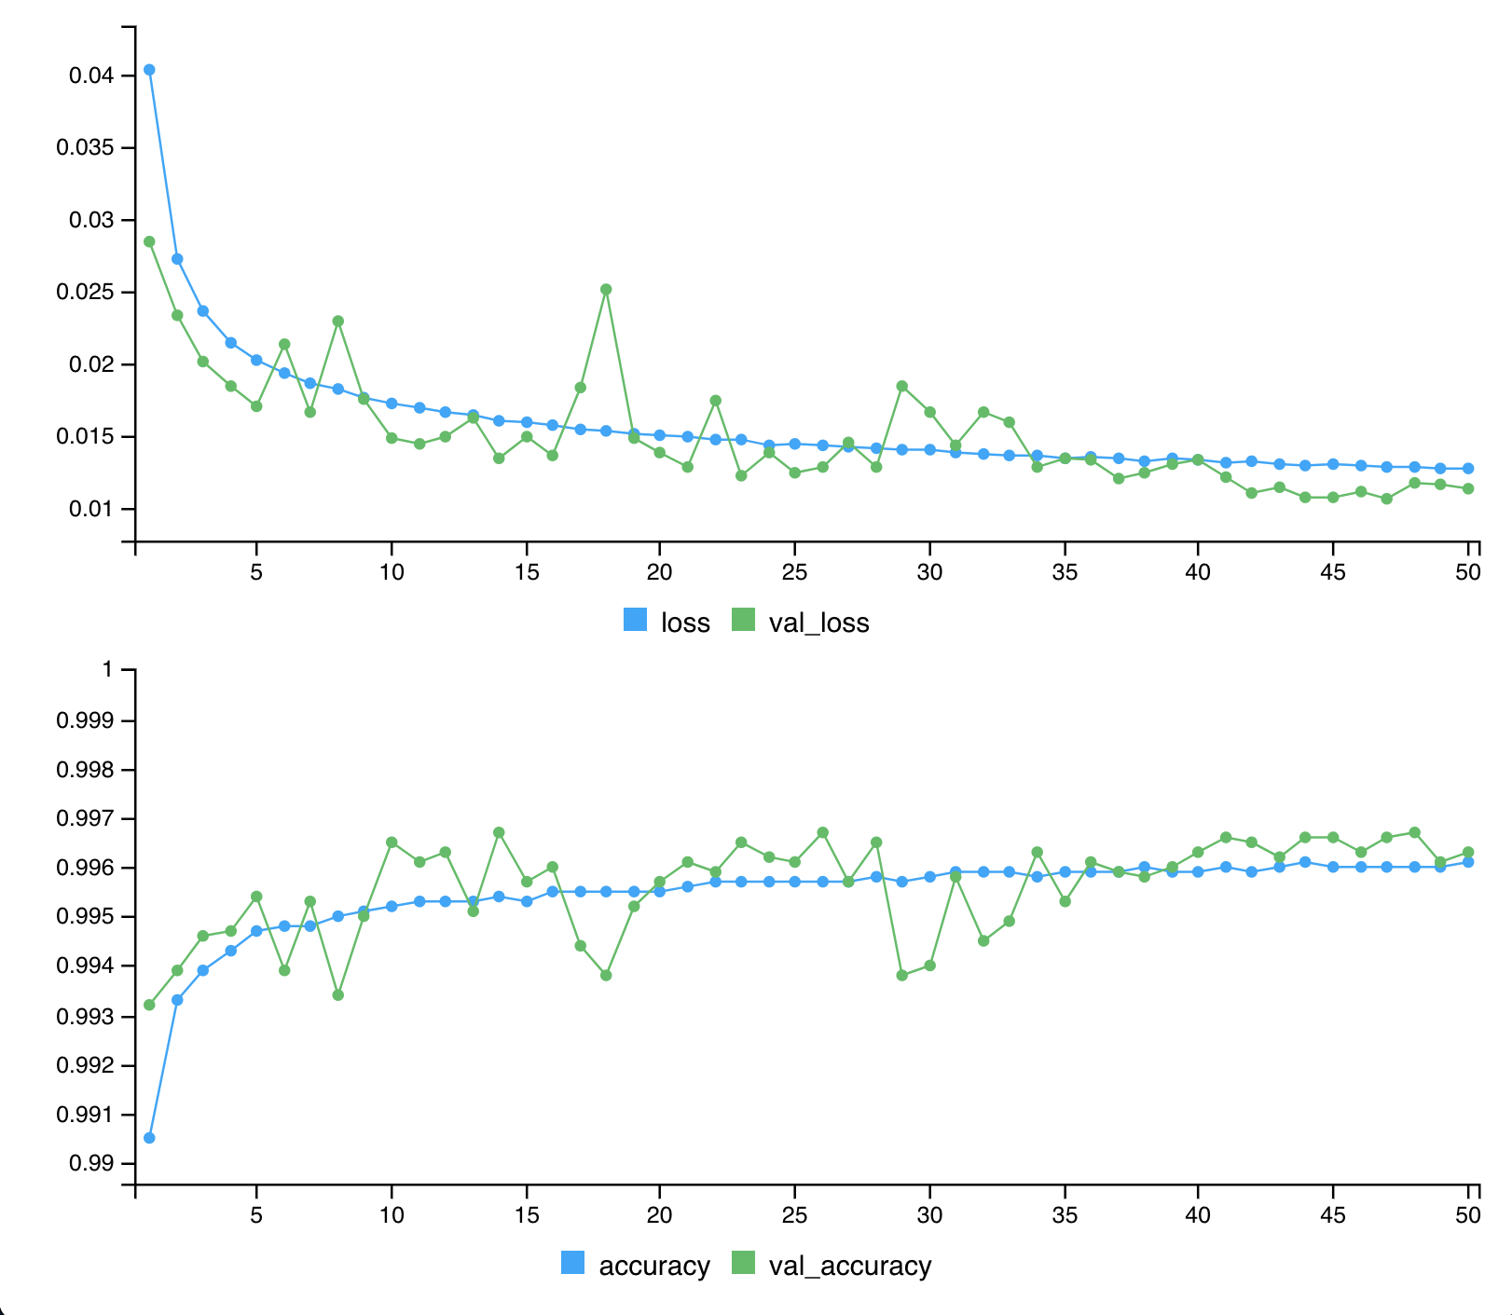
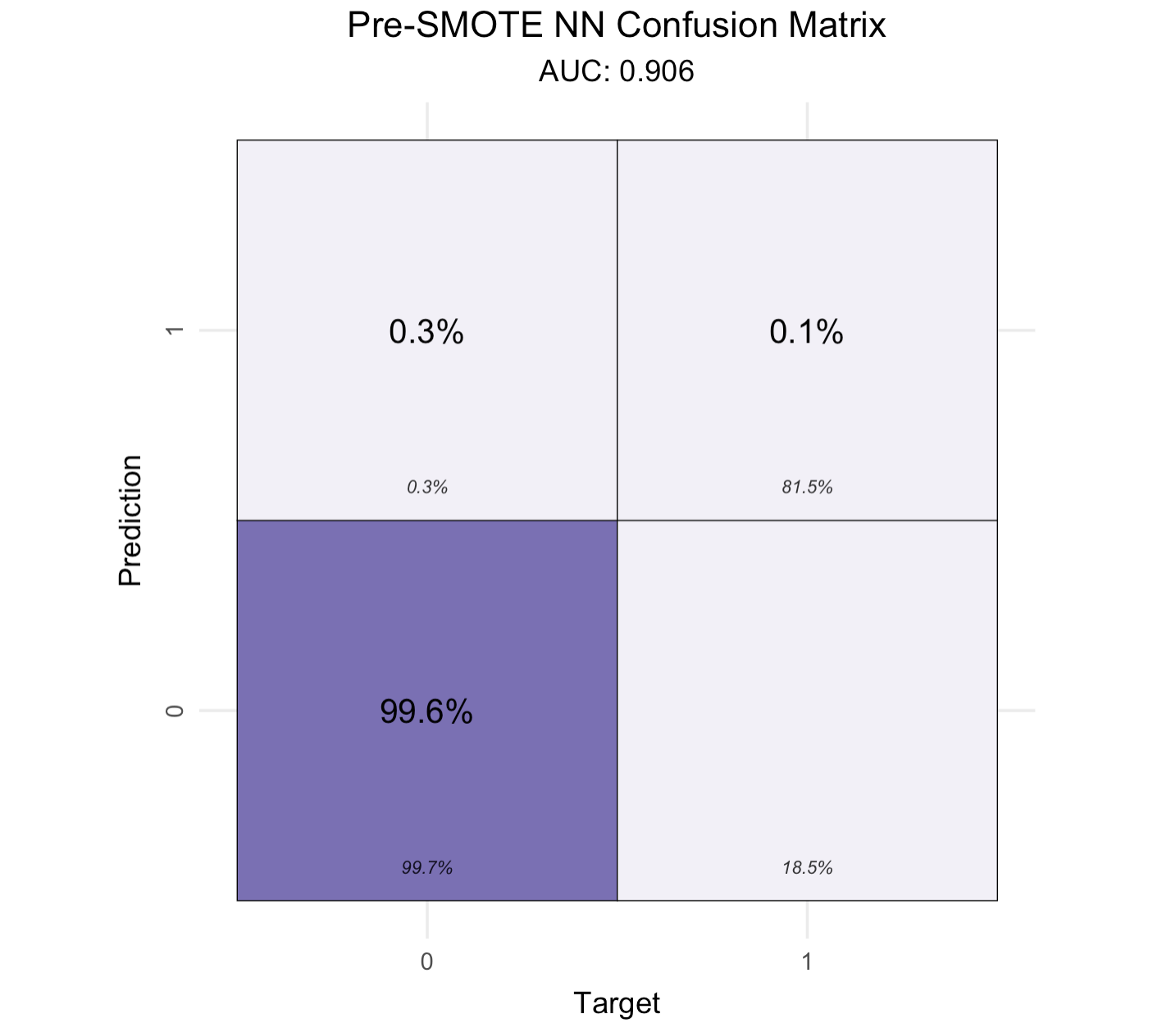
Pre-SMOTE Neural Network Parameters: 8 layers Activation functions: LeakyRELU (3), Tanh (4) & Softmax (1) Dropout Rate: 0.1(for 1 layer) 70-30 Validation Split

Slide 9
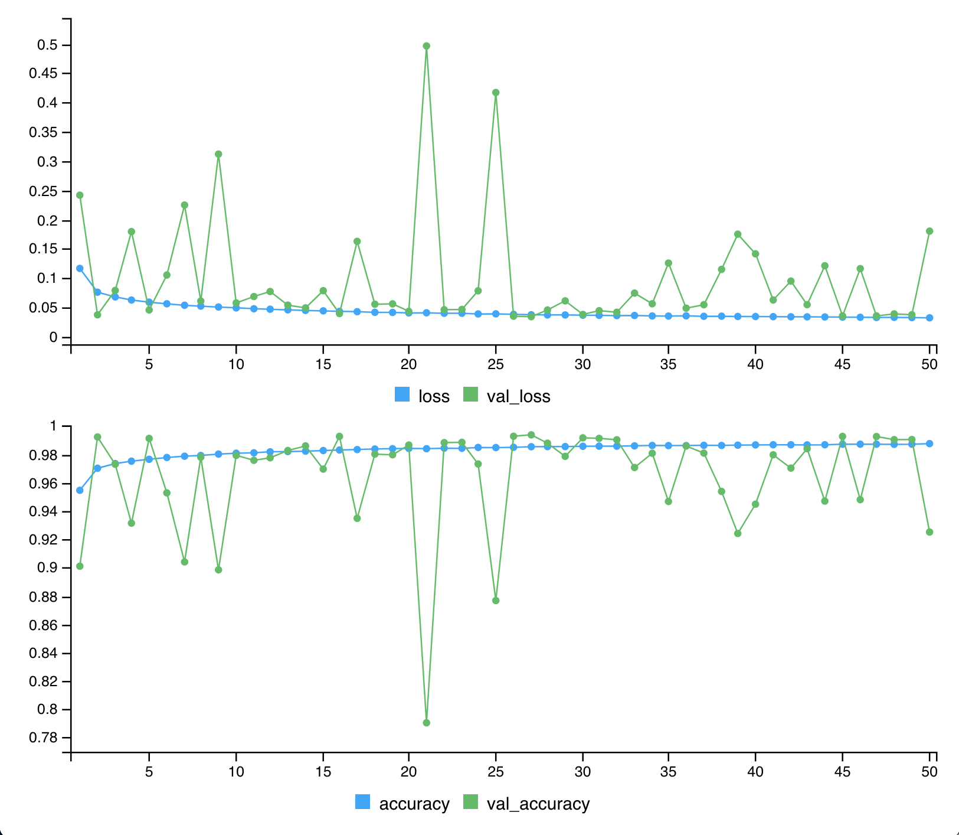
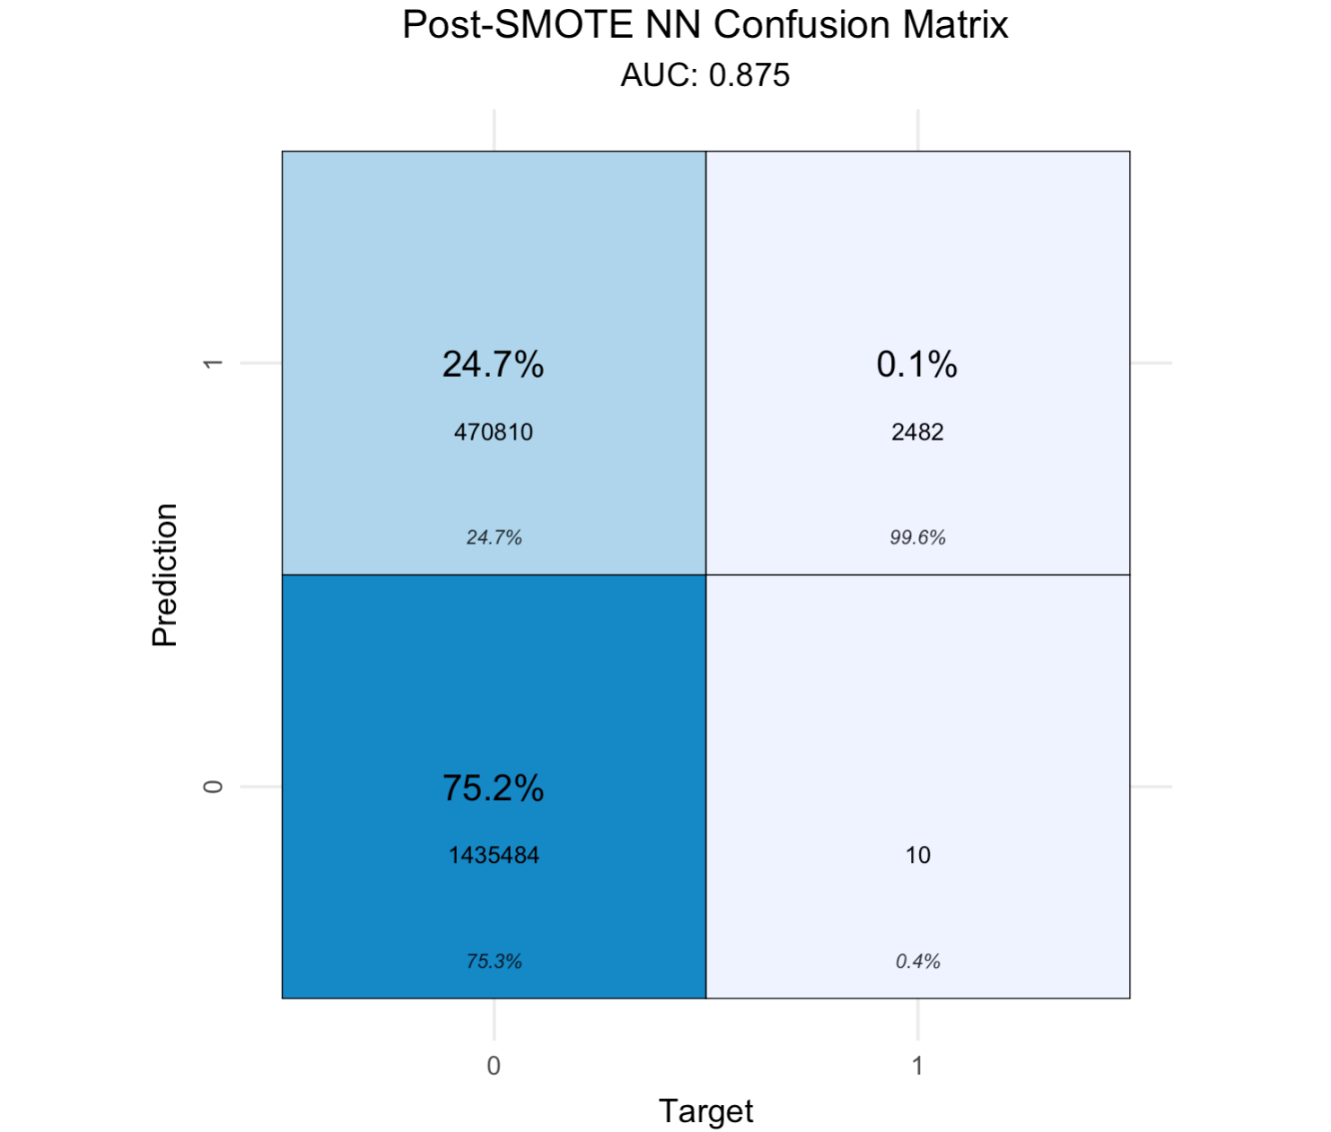
Post-SMOTE Neural Network with same parameters
Sensitivity: 75.3%
Specificity: 99.6%

Slide 10
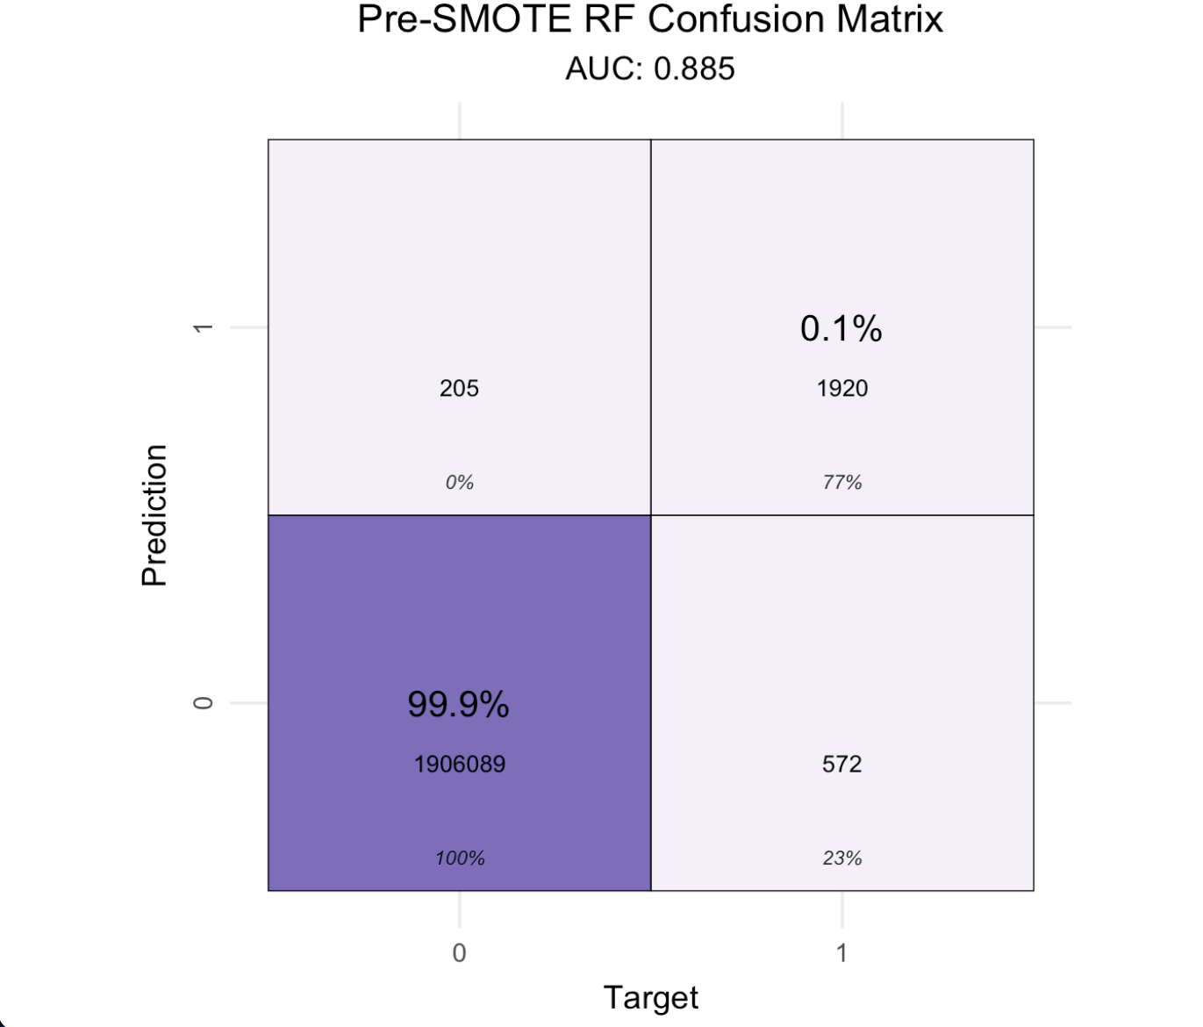
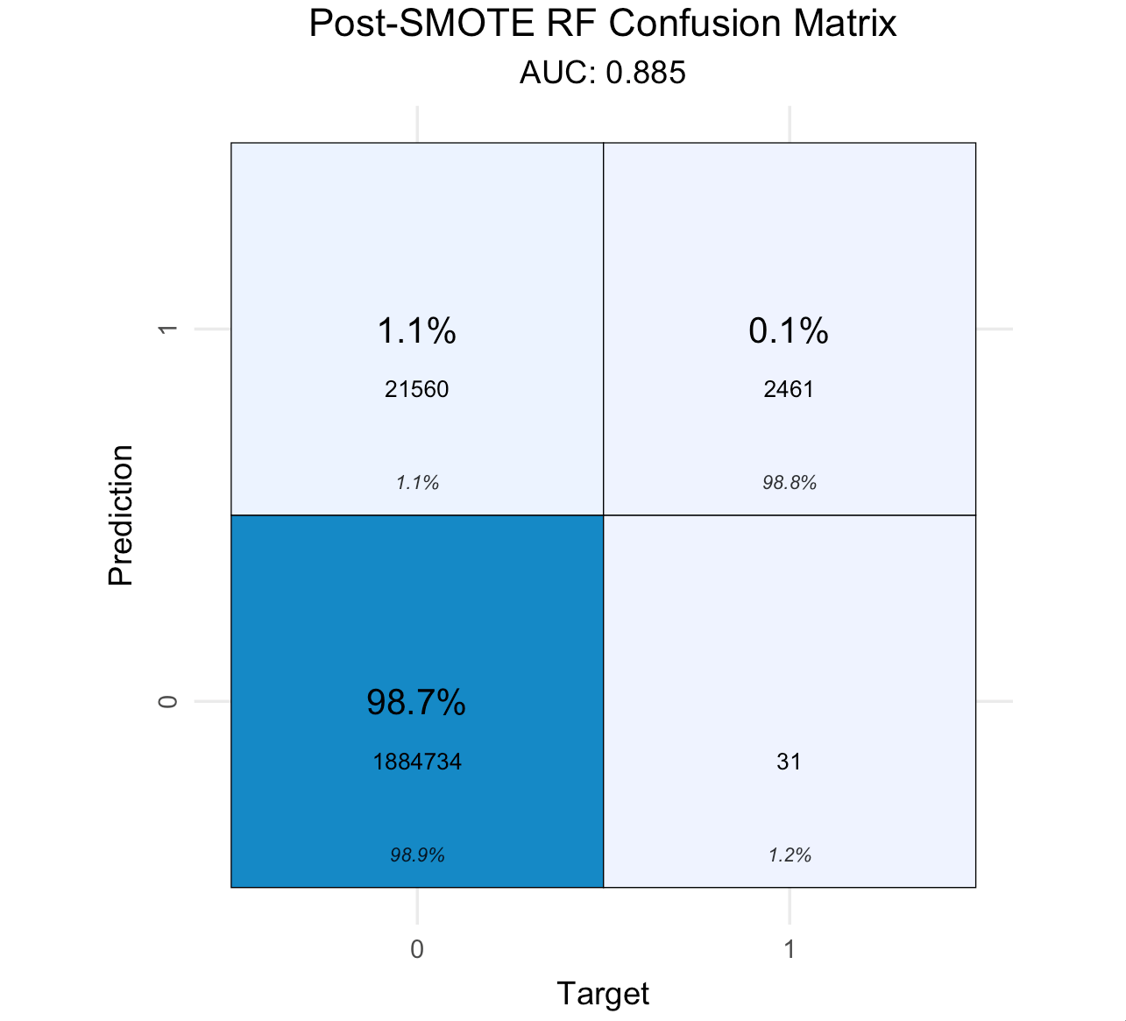
Random Forest
Pre-SMOTE
Sensitivity: ~100%
Specificity: 77%
Post-SMOTE
Sensitivity: 98.9%
Specifity: 98.8%

Slide 11
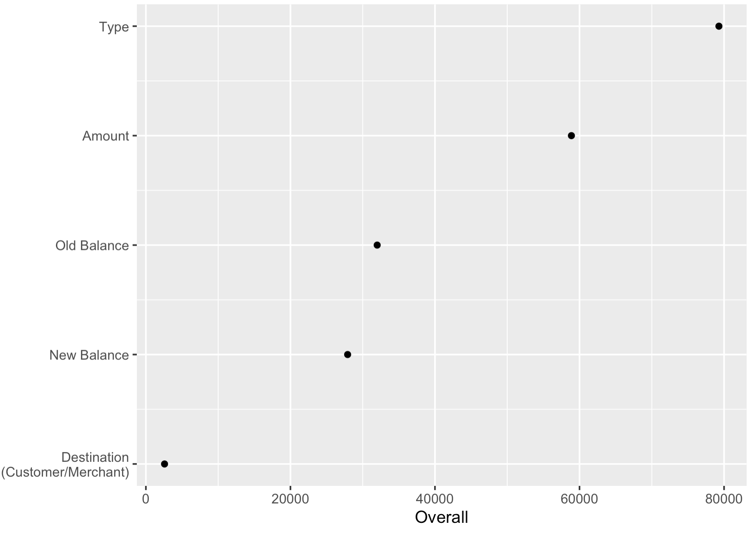
Conclusion
At the current scale, Random Forest + SMOTE perform exceptionally well. RF’s classification rate is almost at perfection compared to Neural Network’s.
Ranking of Variable Importance (Mean Decrease in Accuracy):
1. Type (Transfer, Debit, Cash)
2. Amount
3. Old Balance
4. New Balance
5. Destination (Customer/Merchant)

Slide 12
Further Investigation
How sustainable is the Random Forest algorithm? If done on a larger scale, can it maintain its efficiency and “accuracy” (Specificity)?
How to improve the Neural Network?

Slide 13
The End
Bad Model
Good Model

